Slide 1


Fast and frugal heuristics
A better way to model policy choice?
By Yvonne Matthews

Slide 2

Background
For the past year I have been working on a post-doc project to improve understanding about how managers decide to fund innovation projects when the future is uncertain
There are plenty of prescriptive theories about how managers should make decisions. But managers usually don’t have enough information to apply these frameworks. Often, they can’t even quantify the risks or potential rewards
Does this situation sound familiar to anyone in environmental management?

Slide 3
Uncertainty terminology
What analysis methods were designed for
Risk
  When we know the probability of each possible future state (e.g. gambling)
Uncertainty
  When we know the possible future states, but not the probabilities (e.g. sea level rise)
Deep uncertainty
  When we don’t know the possible future states (e.g. new technologies or diseases)
Ambiguity
  When we can’t even agree on the current state

Slide 4
Introducing heuristics
A “heuristic” is a decision rule that is not necessarily optimal. It may involve mental shortcuts or use of less-than-full information
Introduced by an economist (Herbert Simon) and appropriated by psychologists (Tversky, Kahneman, Gigerenzer)
2 research streams:
  Normative – how people actually make decisions
  Prescriptive – how people should make decisions

Slide 5
How people actually make decisions
People frequently depart from the standard model of utility maximisation
Behavioural labels include: satisficing, take-the-best, elimination-by-aspects, lexicography
When do people follow the standard of “rationality”?
  When making decisions that they encounter frequently, and have experienced the consequences
When do they not?
  When the options are unfamiliar to them
  When their preferences have thresholds (i.e. minimum acceptable quality)
  When they are uncertain about the outcomes
  When it’s too difficult
  When they are short of time
  When they don’t care

Slide 6
Models of Decision Making
Random utility choice models based on rational expectations are still widely used. Why?
  Numerous extensions to accommodate “non-standard” behaviour
  In aggregate, it approximates reality
  Choice experiments are designed to encourage “standard” behaviour
An alternative: fast-and-frugal trees
  Built from highly flexible non-linear building blocks of disjunctions and conjunctions
  Accounts for the bounded nature of cognition and information
  Useful for understanding the microeconomic foundations of decisions

Slide 7
All about Fast-And-Frugal Trees
They are fast because they allow a decision as soon as the crucial important information has been evaluated
They are frugal because only one piece of information is evaluated at each branch
For the psychological justification see Gigerenzer et al. (1990s onwards)
For the specification see Martignon et al. (2003 & 2008)
For the connection with economic theory see Braithwaite et al. (2017)
To try it yourself use the R package FFTrees (Phillips et al., 2017)

Slide 8
Back to the Manager experiment
For the project about business innovation decisions I developed a choice experiment and we got actual managers to answer it
I fitted both random-utility choice models AND fast-and-frugal trees to the choice data
  Compared predictive accuracy
  Compared the decision rules used with management theory

Slide 9
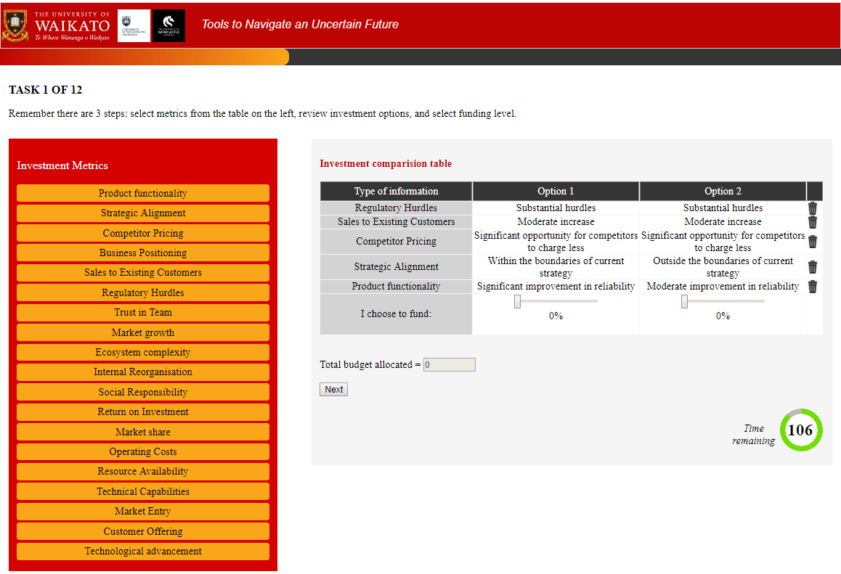

Slide 10
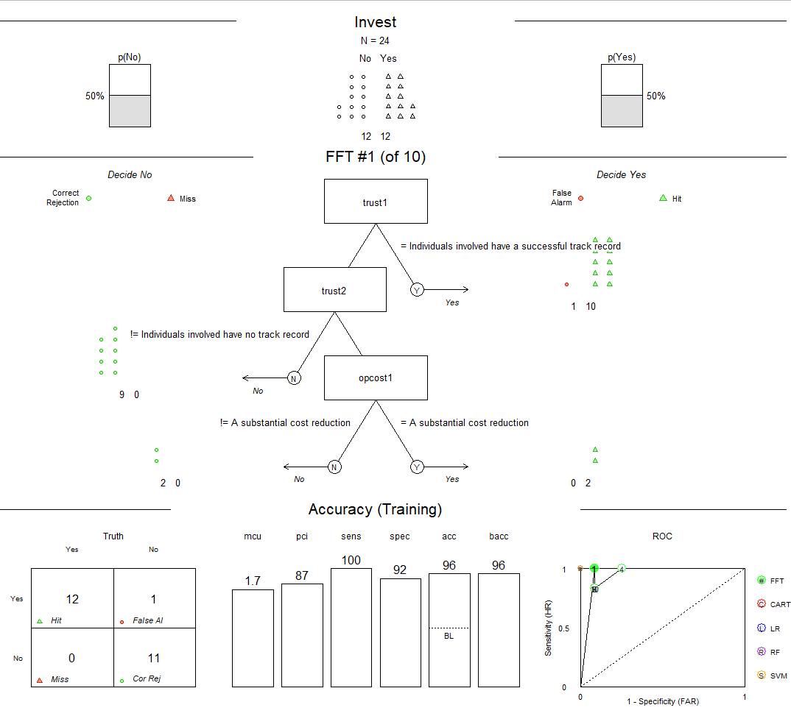
Example FFT output
If individuals involved in this project have a successful track record, decide Yes.
If Individuals involved in the other project do not have no track record, decide No.
This project does has a substantial cost reduction, decide Yes, otherwise, decide No.

Slide 11
KEY RESULTS
FFT had better average predictive accuracy
FFT was more likely to be a better fit for experienced managers
Experienced managers used less information and had more stable rules

Slide 12
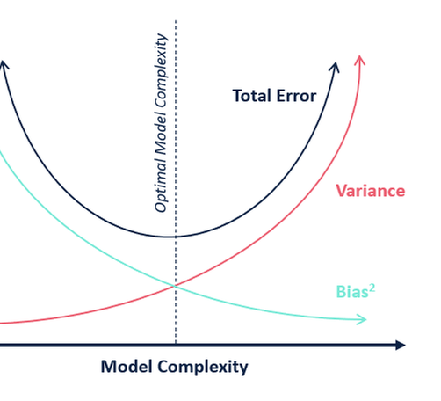
When heuristics are rational
Using full information (e.g. MNL) fits existing data better
But simple rules make better out-of-sample predictions
  Evidence from finance, business, medical diagnoses, forecasting
“Ecological rationality” requires evaluation and adaption

Slide 13

When should we use FFTREEs
…to explain or predict choice?
When we want to understand choices at a micro level
E.g. support for a policy
When non-linear thresholds are expected
E.g. constraints or minimum acceptable levels of water quality
When the context is ambiguous or uncertain
E.g. people ignore information that doesn’t fit their beliefs

Slide 14
When Should we use FFTrees
…for making decisions?
Implementation: does the decision need to be made quickly, without computational aid?
FFTrees are easy to remember and use
Costs: is it costly to gather relevant information?
FFTrees are frugal
Transparency: is it important to understand how the algorithm works?
FFTrees can be explained with simple rules
Easy to check if it fails
Prediction accuracy: is it similar or better than alternatives?
FFTrees are robust when data is scarce or highly variable

Slide 15
When not to use FFTrees?
When there are many weakly predictive but related cues
When another model has been proven better in this context

Slide 16
What next?
The project about managers is wrapping up
Next I am going to apply the same methods and tools to environmental policy decisions
I am now designing a choice experiment to analyse:
  Policy developers’ preferences for “economic instruments”
  Decision rules used by experienced vs. graduate policy developers
  Decision rules used when outcomes are relatively certain vs. deeply uncertain

Slide 17
Final words: how to be an ecologically rational economist:
cross-validate
evaluate
adapt

Slide 18
Abstract
Traditional economic theory would have us believe that rational decision-making requires full information and complete evaluation of all options. We have long known this is not how people usually make decisions. There is a mountain of literature about heuristics (simple rules) and biases which have condescendingly explained heuristics as shortcuts people use when they lack time or mental capacity.
However, the real world often has too much uncertainty and ambiguity to make optimal decisions even with advanced computer models supporting our limited brains. Predictive accuracy involves a trade-off between bias and variance, with more complex models having higher variance. Recent studies have found - counter-intuitively - that simple decision rules using key pieces of information can out-perform optimization models using full information. Heuristic models not only explain choices better, but also lead to better and more robust outcomes in many situations. Evidence of this has been reported in areas such as financial investment, medicine, management, and marketing. What’s more, expert decision-makers tend to use less information than novices. This new understanding of rationality is known as “ecological rationality” and requires learning and adapting decision strategies to the decision environment.
What are the implications of this paradigm shift for environmental and resource economics? Environmental issues are synonymous with uncertainty and ambiguity, so traditional risk analysis and optimization models may not be “ecologically rational”. In this presentation I demonstrate the use of an R package to fit Fast and Frugal Trees - a heuristic classification tool - to a choice experiment data set. I show how to identify the rules individuals used, and compare predictive accuracy with the MNL family of choice models. Finally, I describe the policy situations under which heuristic models might provide useful insights, and their limitations.

