Slide 1

In-Paddock Delivery of Methane Inhibitors for Pasture-based Dairy:
An Economic Analysis Incorporating Scenario Planning
Marmont, Silva-Villacorta, Dorner, Eastwood, Minnee & Neal

Slide 2


Methane and New Zealand Dairy
Notes:
Bullet points of content:
Zero Carbon Bill Commitments (Net zero by 2050, except biogenic methane with step changes.)
Methane emissions in ruminants like dairy cows are linked to intake
Reducing cows numbers and tweaking system
Details
NZ needs to reduce emisisons, specifically biogenic methane levels in accordance with commitments under the Paris Accord, legislated by the ‘Zero Carbon Bill.’
Note the temporal targets (10% on 2017 levels by 2030, 24-47% on same baseline by 2050)
Biogenic methane life-cycle mention, warming effects and link to dry matter intake
How to meet the targets? Cut cow numbers, system optimisation may get some way but not completely.

Slide 3
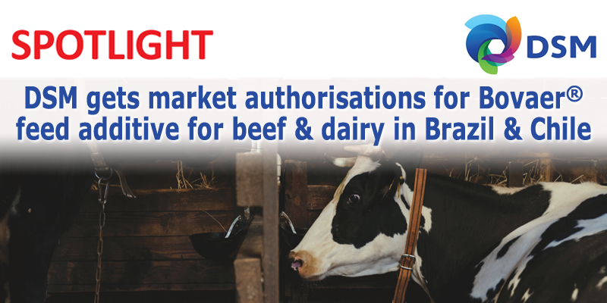
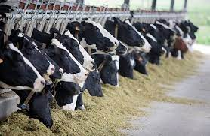
Methane Inhibitors
Notes:
Talking points:
What are methane inhibitors
What are the requirements of methane inhibitors
Global notes of inhibitors (define TMR)
How do inhibitors fit into NZ
In shed
Note that one study mimicking in-shed (2x delivery/day, w/ delay) showed no mitigation
A little and often is key to maximising the mitigation potential of the compounds
Methane inhibitors are compounds which when consumed in appropriate doses and frequencies cause the production of methane in the rumen to be reduced. In the case of 3-NOP ‘Bovaer’ produced by DSM this occurs by inhibiting the final stage of methanogenesis, the process of converting hydrogen into methane. Another notable inhibitor is Asparagopsis a red seaweed endemic to NZ + Australia, it has the potential to have a greater mitigation effect on emissions, but is further away from being offered to the market. There are many trials investigating the efficacy and effects of such compounds and they are shown to have no impacts on animal health, or leave residuals in the milk or meat.
While methane inhibitors are not currently on the market, DSM are currently building a factory in Scotland with the goal of having capacity to offer a global supply of the product, which has begun to be legislated for use in parts of the world (Brazil, Chile, European Union.)
However, in NZ, the question is how do we get the compounds to the animals at specific doses and frequencies required for the desired effect. In Total Mixed Ration systems shown on the right it is relatively easy to mix the food into every mouthful of feed. In NZ, approximately 30% of farmers have in-shed feeding, which would be one possible way of delivery the compounds. However, in-shed feeding will likely not offer significant inhibitory effects due to the frequency with which animals interact with it. That is, if farmers run milking different from TAD, or in the off-season animals will not receive a dose twice a day, which is the lowest frequency currently explored in trials (due to the fast decline in inhibitory effect post consumption.) Further, consumption at the shed cause some of the peak inhibition time to be lost before the cows can walk back to the paddock.

Slide 4
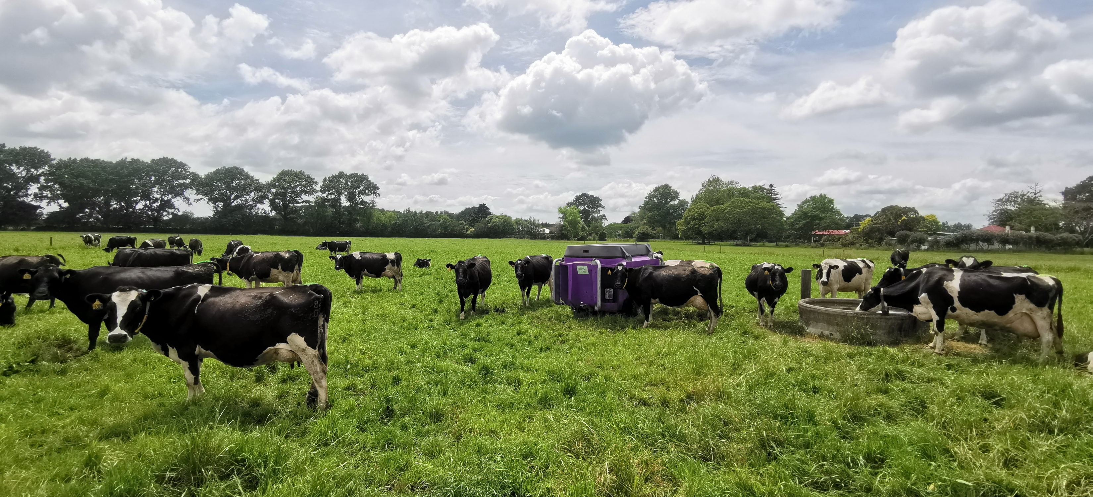
In-Paddock Smart-Feeders
Notes:
Talking points:
Describe smart feeders
How they address requirements of smart feeders
Note not a purpose built technology (it is NOVEL, and not currently ready)
Do they have sufficient precision
Brief description of the technology, and how it solves the issue of delivery frequencies and maximising inhibition window.
Note that the technology is not designed for small, but frequent doses which is ideally what we want from smart-feeders, so a smart-feeder for this application is not currently ready to go ‘out of the box.’

Slide 5
Research Questions
What is the breakeven methane price of this mitigation approach?
How does this approach perform in different farm systems?
Notes:
The ultimate output is the methane price regardless of the emissions pricing framework (ETS V HWEN)
What farm systems perform better with the approach than others

Slide 6
Implementation Costs
Additional Labour
Additional supplement (feed)
Smart-feeder rental
Methane inhibitor
Notes:
Talking points:
Define Labour
Define Supplement
Note substitution of supplement
Define Smart feeder costs
Define inhibitor costs
Talk through the costs and the order of importance to farmers v what the model says has the highest costs
Not there is some substitution for those farms already feeding high quality supplement, for them there is a smaller cost difference between the supplement required for this approach and their incumbent feed.

Slide 7
Method
Farm Descriptors
Region | Waikato
Effective hectares | 109
Peak cows milked | 310
Kg milksolids sold | 121,500
Payout Received ($/kg MS) | 7.00
Develop farm financial performance model
Scale to reflect inhibitor delivery costs
Determine breakeven methane price
Notes:
Talking points:
Data source (emphasis on region and milk solids)
Model method
Build in costs
Methane Emissions Profile
Methane reduction
Apportion implementation costs
Model output (breakeven price of adoption)
Note Breakeven refers to emissions charge + any incentive.
Discuss data source (NZ Economic Farm survey from the DNZ Economics Group)

Slide 8
Assumptions
Mitigation levels equivalent to those of TMR systems can be achieved
A ‘premium’ pelleted supplement is required for dispensation
Ability to purchase supplement with inhibitor included in NZ
Notes:
TMR systems continuous in diet, short effectiveness window not an issue.
Prevent stratification in the hopper
Legislated for use in the food chain, able feed suppliers coming to party

Slide 9
Scenario Analysis
Notes:
Talking points:
These are the inputs in the scenario analysis
Note the differences inhibitor (consistent with literature)
In-shed only could potentially be 0% reduction
Flow on effects to pasture utilisation (most economic feed)

Slide 10
Preliminary Results
Notes:
Talking points:
Smaller bars are favourable
In-shed feeding is not a good option (something along this line preferred in focus groups based on using existing infrastructure)
Under HWEN estimate of methane price is $2.30+
Note differences between the model and focus groups in other work
Labour was major
Note HWEN CH4 Price is $0.11/kg CH4 + upto 20x that in incentive (total ~$2.40, breakeven methane price in the favourable scenario is $2.80)

Slide 11
Challenges
Farm system paradigm shift
Uncertainty (price and availability)
Technological performance
Notes:
Talking points:
Farm System paradigm shift
- Assuming that inhibitor use via smart-feeders can be ironed out to reach the levels of mitigation seen elsewhere
- The costs discussed before are largely uncertain (inhibitor and machine costs)

Slide 12
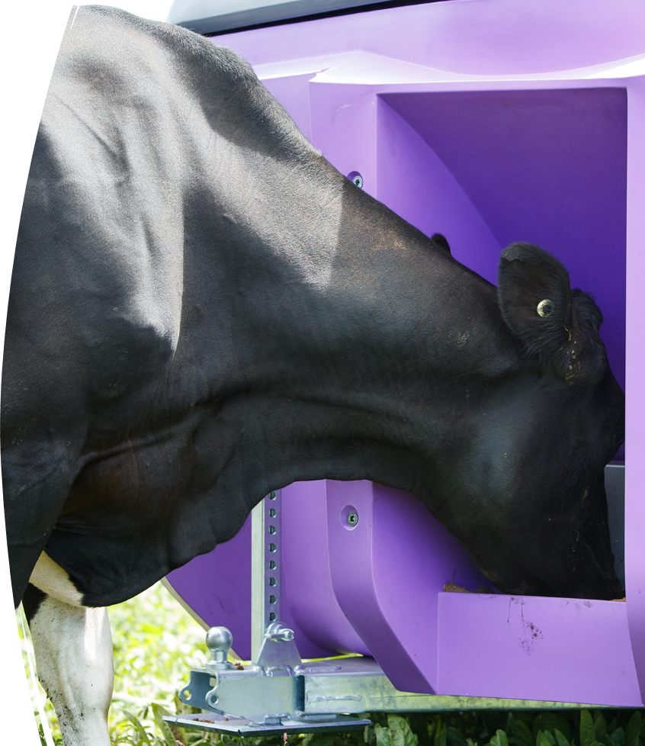
Implications
Viable in optimistic cases
Many challenges
Inhibitor and smart-feeder manufacturers are being fed back these findings
Not a silver bullet
Notes:
Talking points:
Higher input systems with substitution have an inherent cost advantage
Doesn’t need to be a silver bullet, perhaps could be additive with other mitigation techniques
There exists a not too unrealistic scenario where it is viable

