Slide 1
Do environmental provisions in the free trade agreements promote green trade?
Masudur Rahman
Visiting Research Fellow
Institute of South Asian Studies- National University of Singapore (NUS)
masudrahman@nus.edu.sg
Notes:
Line spacing + Page numbers

Slide 2
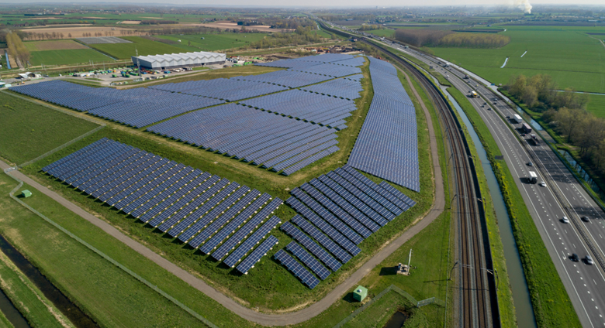
Structure
1. Background 2. Literature 3. Data & Methodology 4. Findings 5. Q & A

Slide 3
Background
New generation of PTA/FTAs (behind the border issues are the key)
In 2018 each new PTA contained on an average 73 different environmental provisions.
The economic effect of the EP are largely remained unclear
Political (public support, environmental diplomacy etc.) and economic (regulatory level playing filed) explanation for growing number of environmental provisions.

Slide 4
Literature & Objective
EP has positive impact on environmental suitability-promoting domestic regulations, reduce air pollution.
Another group, EP reduce trade, and which is against of FTA/PTA narrative
Questions is whether EP into the FTAs exacerbate the trade off between environmental provisions and economic development.
Clara et al., (2020) show EP can help green exports and decrease dirty exports from developing countries.

Slide 5
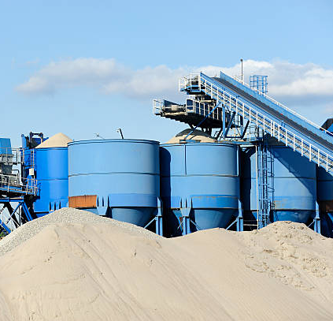
Literature & Objective
Motivations of incorporating EP in the FTA is ambiguous and trade impact is remained unclear in literature.
Do environmental provisions in FTAs increase in exports of green goods?
Do environmental provisions in FTAs decrease in exports of dirty goods?
We tested for three different group of countries- world: developing countries, NZ

Slide 6
Data
PTA/FTAs related data
Trade and Environmental Database (TREND) prepared by Morin et al., (2018) which is developed by Design of Trade Agreements (DESTA) dataset (Dur et al., 2014)
Trade Data
UNCOMTRADE for bilateral exports data (1995 to 2019)
OECD and EUSTAT Green Goods (HS 6-digit classification)
Dirty goods: Three digit –Standard International Trade Classification (SITC)
Developing countries World Bank Classification

Slide 7
Methodology-Gravity Model
SHARE_{eit} =β₁*ENVPROVS_{eit} + β₂*FTA­_{eit} + α_{ei}+ α_{et}+ α_{it} +ε_{eit}
SHARE ( 0 to 1)
ENVPROVS absolute value and FTA­/PTA dummy
α_{ei ,} α_{et,} and α_{it} Country pair, and export and importer fixed effect
PPML estimation also used

Slide 8
Table 1
Results Discussions

Slide 9
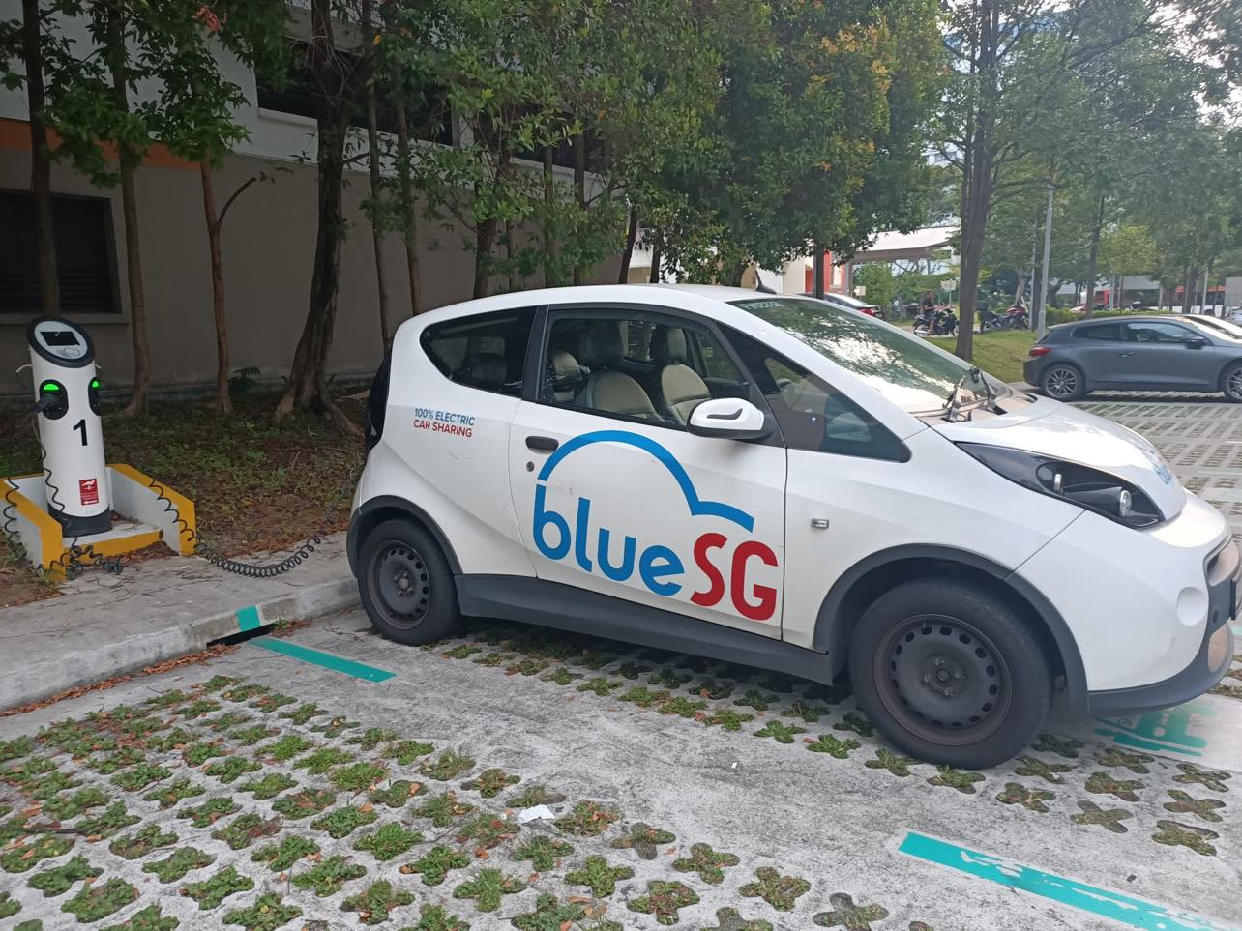
Table 2

Slide 10
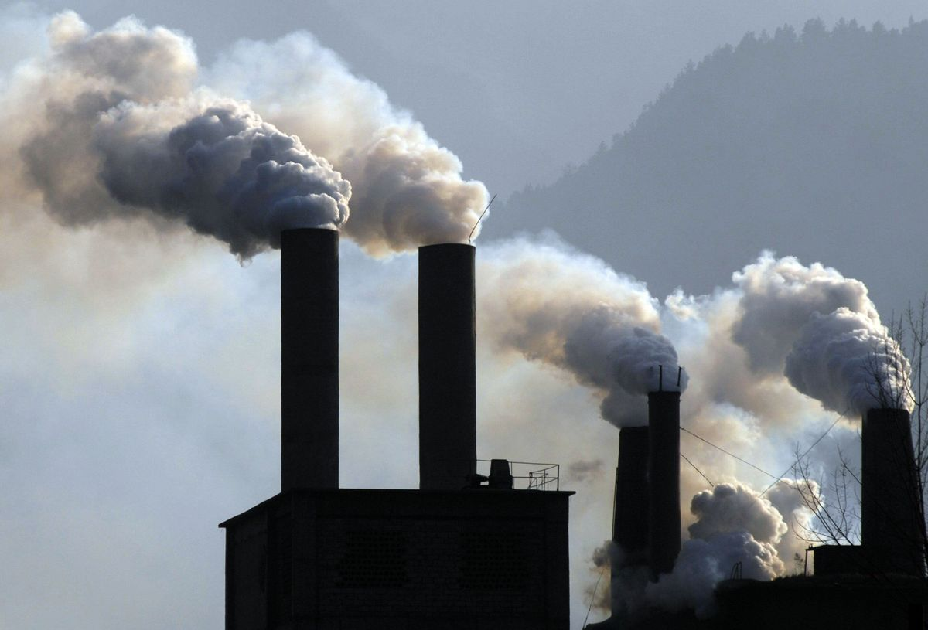
Table 3

Slide 11
Conclusion
We assess the environmental provisions in the FTA on trade flows at the sectoral level.
FTA/PTA has significant impact on trade.
Environmental provisions don’t substantial limit on trade.
Developing countries have positive impact on green trade.
EP has no impact on NZ exports on exports in green products but decrease in dirty products.

Slide 12
Do environmental provisions in the free trade agreements promote green trade?
Q & A
Masudur Rahman
School of Accounting Finance and Economics (SAFE)
The University of Waikato &
Visiting Research Fellow
Institute of South Asian Studies- National University of Singapore (NUS)
masudrahman@nus.edu.sg
Notes:
Line spacing + Page numbers

